Slide 1


Notes:
© Copyright PresentationGO.com – The free PowerPoint and Google Slides template library

Slide 2
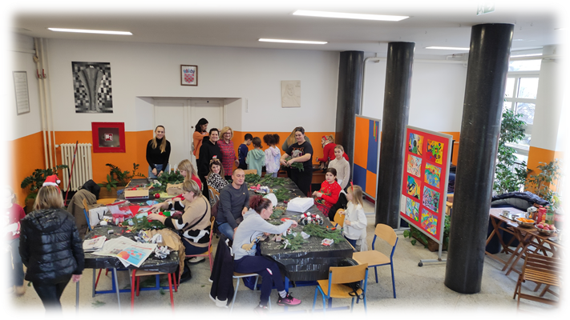
Notes:
© Copyright PresentationGO.com – Free Templates & Infographics for PowerPoint and Google Slides

Slide 3
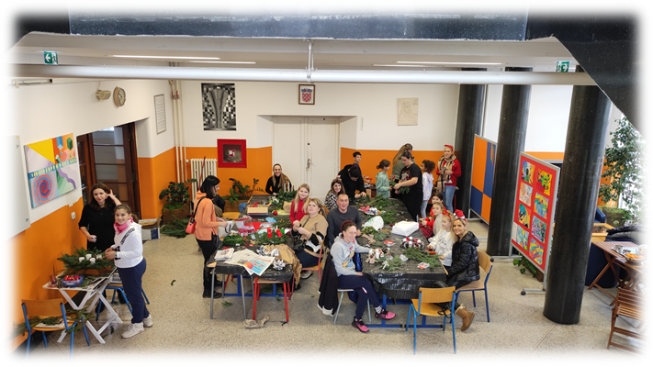
Notes:
© Copyright PresentationGO.com – Free Templates & Infographics for PowerPoint and Google Slides

Slide 4
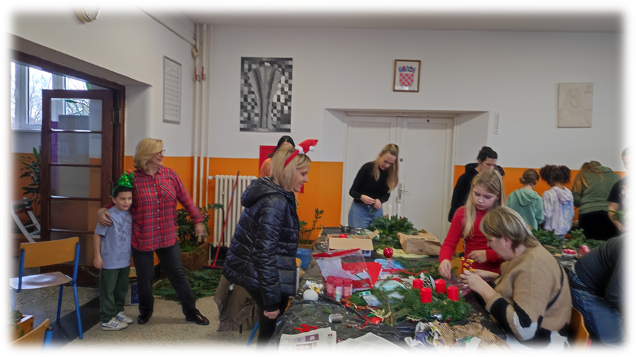
Notes:
© Copyright PresentationGO.com – Free Templates & Infographics for PowerPoint and Google Slides

Slide 5


Notes:
© Copyright PresentationGO.com – The free PowerPoint and Google Slides template library

Slide 6


Notes:
© Copyright PresentationGO.com – The free PowerPoint and Google Slides template library

Slide 7


Notes:
© Copyright PresentationGO.com – The free PowerPoint and Google Slides template library

Slide 8

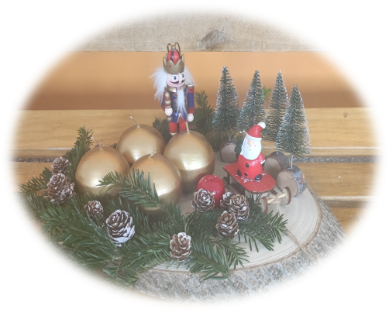
Notes:
© Copyright PresentationGO.com – Free Templates & Infographics for PowerPoint and Google Slides

Slide 9


Notes:
© Copyright PresentationGO.com – The free PowerPoint and Google Slides template library

Slide 10


Notes:
© Copyright PresentationGO.com – Free Templates & Infographics for PowerPoint and Google Slides

Slide 11


Notes:
© Copyright PresentationGO.com – The free PowerPoint and Google Slides template library

Slide 12

Notes:
© Copyright PresentationGO.com – Free Templates & Infographics for PowerPoint and Google Slides

Slide 13


Notes:
© Copyright PresentationGO.com – Free Templates & Infographics for PowerPoint and Google Slides

Slide 14


Notes:
© Copyright PresentationGO.com – The free PowerPoint and Google Slides template library

Slide 15

Notes:
© Copyright PresentationGO.com – Free Templates & Infographics for PowerPoint and Google Slides

Slide 16
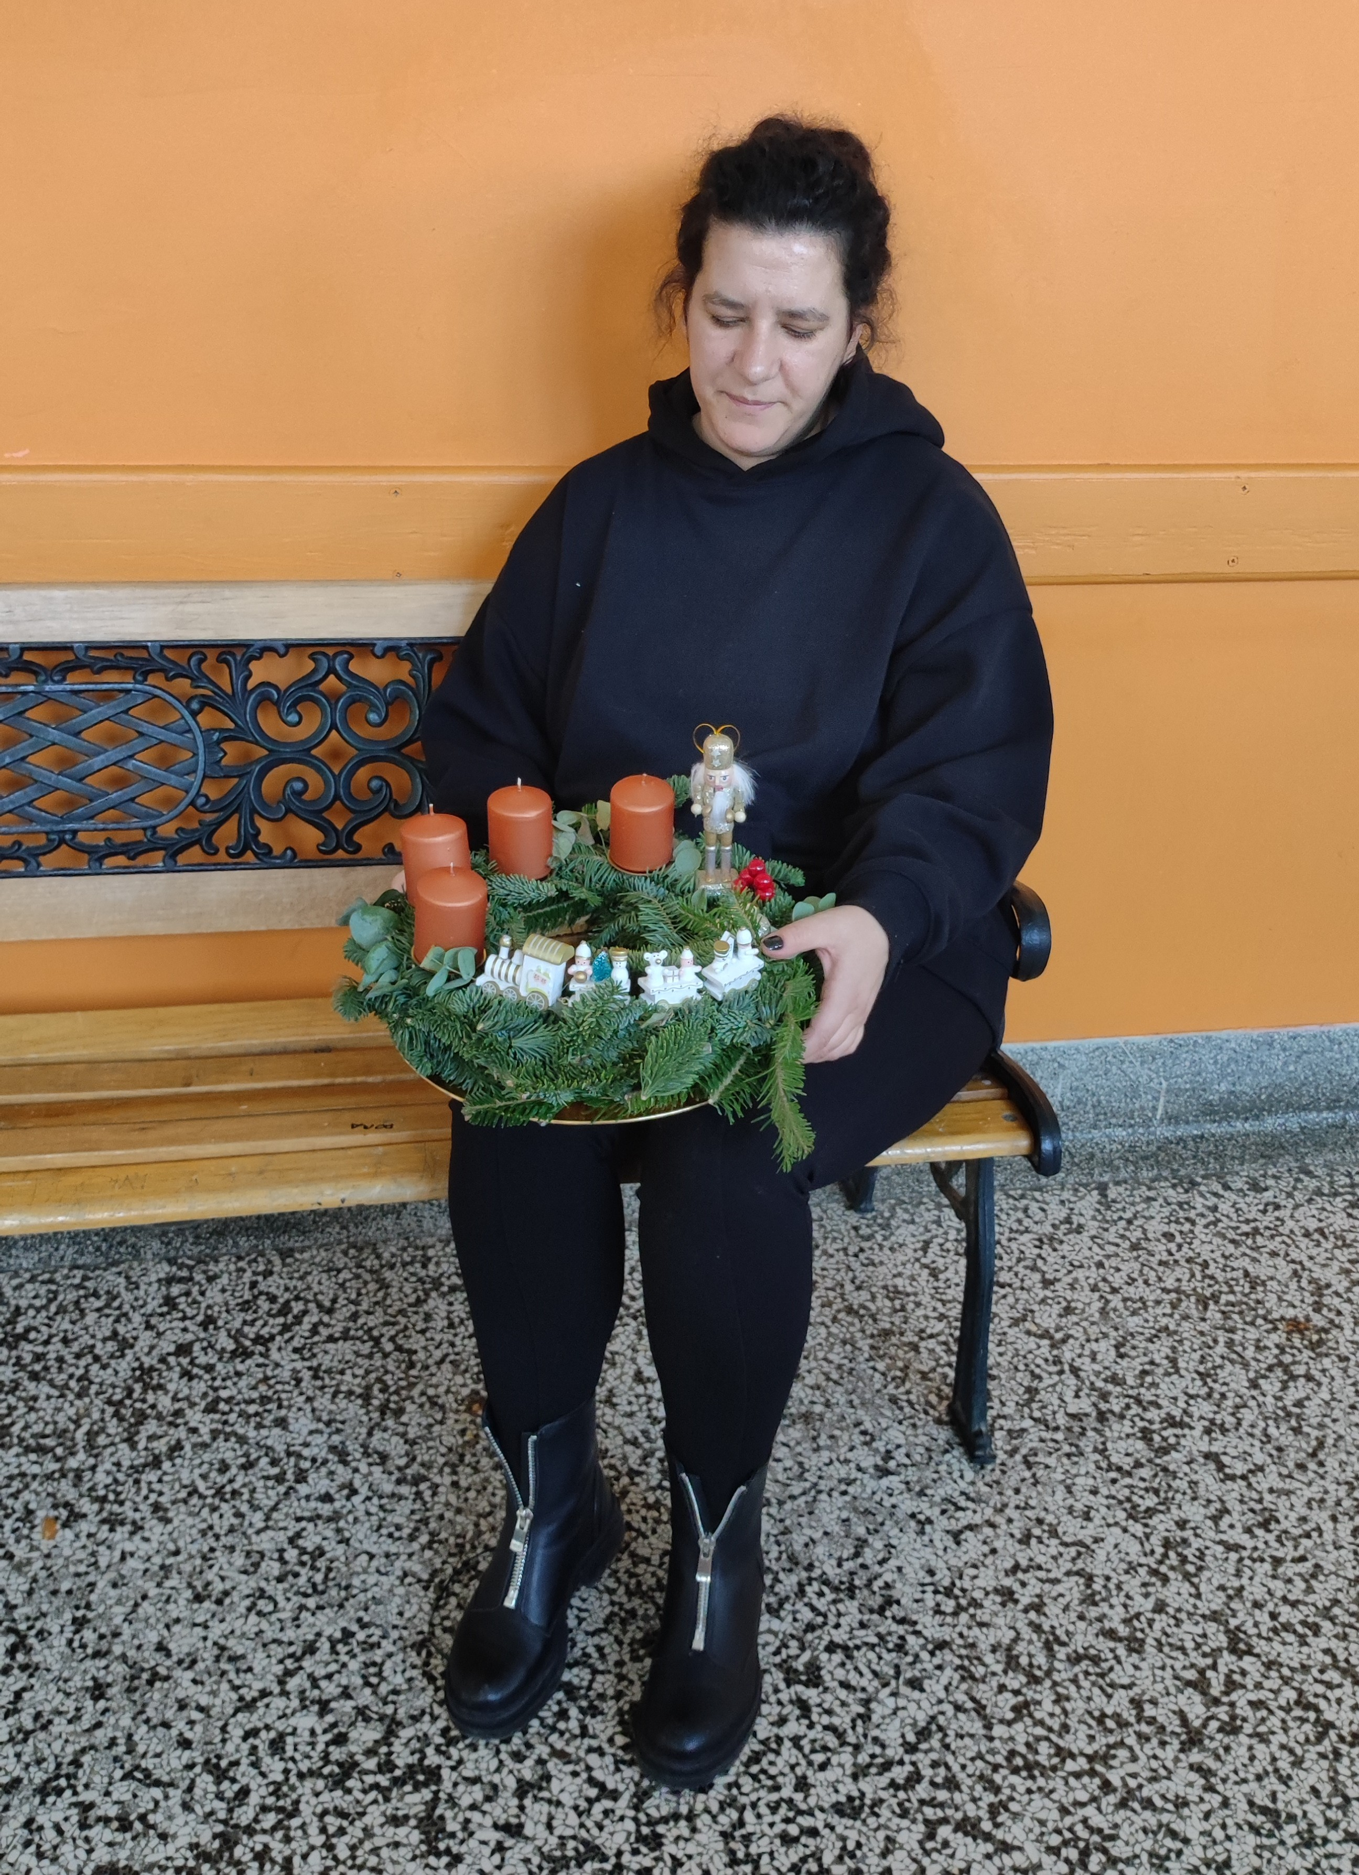

Notes:
© Copyright PresentationGO.com – The free PowerPoint and Google Slides template library

Slide 17


Notes:
© Copyright PresentationGO.com – The free PowerPoint and Google Slides template library

Slide 18


Notes:
© Copyright PresentationGO.com – The free PowerPoint and Google Slides template library

Slide 19


Notes:
© Copyright PresentationGO.com – Free Templates & Infographics for PowerPoint and Google Slides

Slide 20


Notes:
© Copyright PresentationGO.com – The free PowerPoint and Google Slides template library

Slide 21

Notes:
© Copyright PresentationGO.com – Free Templates & Infographics for PowerPoint and Google Slides

Slide 22

Notes:
© Copyright PresentationGO.com – Free Templates & Infographics for PowerPoint and Google Slides

Slide 23

Notes:
© Copyright PresentationGO.com – The free PowerPoint and Google Slides template library

Slide 24

Notes:
© Copyright PresentationGO.com – Free Templates & Infographics for PowerPoint and Google Slides

